Slide 1
Python Based RESTful APIs
Kyung Hee University
SIAT Members

Slide 2
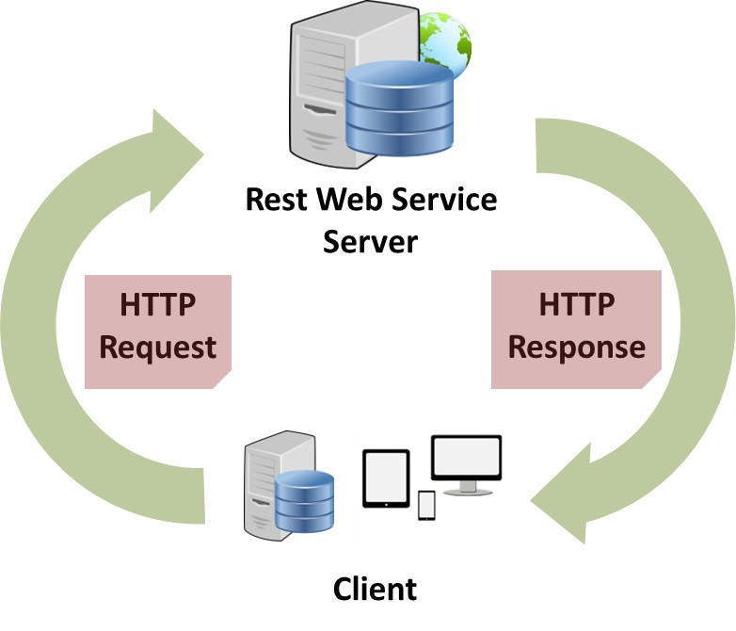

Python based Restful CNN APIs - Scenario
SIAT Cloud
Server Code
Process data using Python Rest APIs
from flask import Flask, request
from flask_restful import reqparse, Resource, Api
from CNNFile import CNN_Fun
class CNN(Resource):
def get(self, dataStoreID):
data = CNN_Fun(dataStoreID) # call to CNN Function
return {'result': str(data)}
def post(self, num):
return {'data sent': str(num)}
api.add_resource(CNN, '/multi/<int:dataStoreID>')
if __name__ == '__main__':
app.run(debug=True, host='163.180.116.xx')
Client Code
Upload Data to SIAT Cloud
url = 'http://163.180.116.xx:5000/multi/' + str(payload)
pr = requests.post(url)
post_data = pr.json()

Slide 3
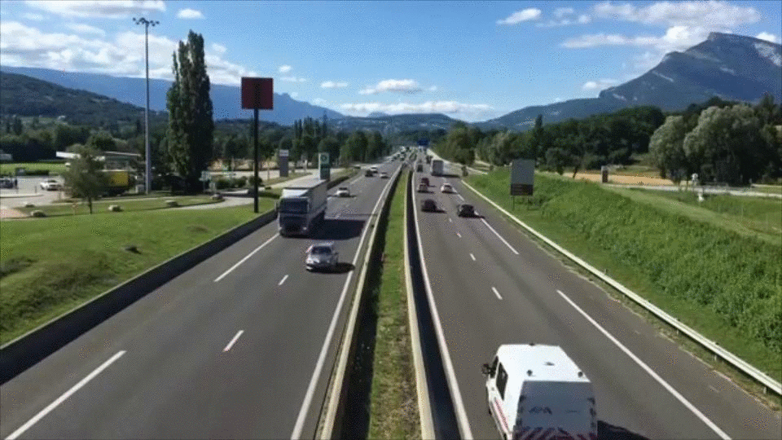
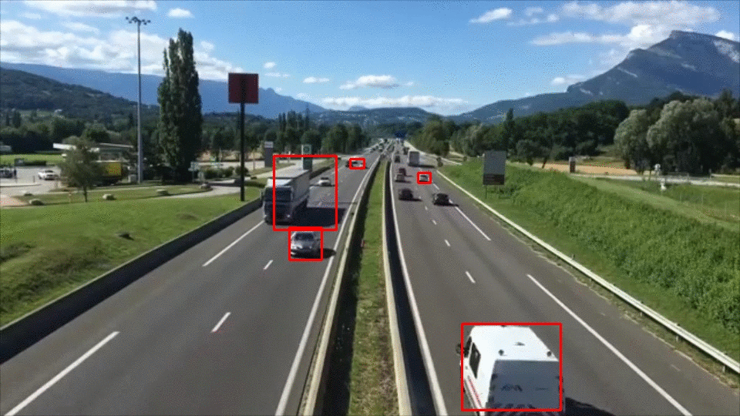
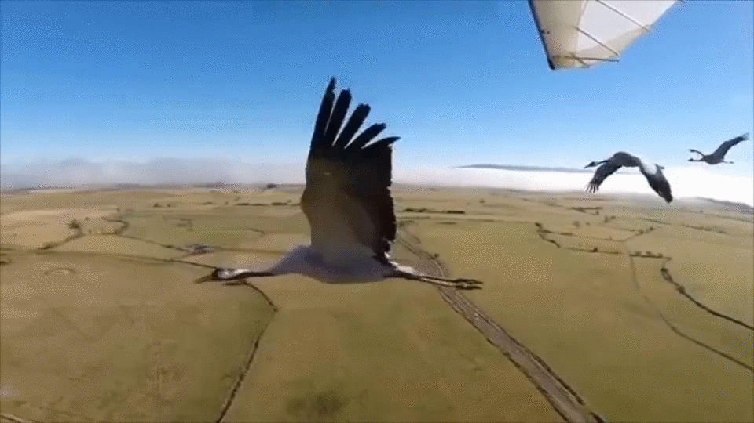
APIs Scenario
Object Detection
Classification API
Object Detection
Preprocessing API
Object Localization
CNN
Feature Extraction
API
Classification
Using CNN
Preprocessing API
Bird is Flying
LSTM Classification API

Slide 4
Python APIs
Function | Input/Ouput | APIs
Object Detection Frame wise | Input: frame Output: object detected frame | url_od = http://163.180.116.234:5000/ODFrameJson/ r_post = requests.post(url_od, data=img_encoded.tostring(), headers=headers)
Object Detection video wise | Input: video Output: object detected video | url_od = 'http://163.180.116.234:5000/ObjectDetection/‘ r_post = requests.post(url_od, data=data)
CNN | Input: video dataset Output: feature for each frame and video in CSV format | url_CNN = 'http://163.180.116.234:5000/CNNFeatureExtractionVideo/‘ r_post = requests.post(url_CNN, data=data)
CNN | Input: Frame Output: Feature | url_CNN = ' http://163.180.116.234:5000/CNNFeatureExtractionFrame/‘ r_post = requests.post(url_CNN, data=img_encoded.tostring(), headers=headers)
LSTM Training | Input: Trained feature and label data Output: Trained Model | url_lstm = 'http://163.180.116.234:5000/TrainingLSTM/‘ r_post = requests.post(url_lstm, data=data)
LSTM Testing | Input: Model and test feature Output: classification result | url_lstm_test = 'http://163.180.116.234:5000/TestingLSTM/‘ r_post = requests.post(url_lstm_test, data=payload_fe)

Slide 5
Object Detection APIs

Slide 6
Object Detection by taking the frame data as input

Slide 7
Object Detection from frame which takes frame as input
# This code detect the object from each frame in SIAT cloud and the video data is read from your computer
# The Processing is done on SIAT cloud
import requests
import cv2
import numpy as np
import base64
import json
import pickle
import time
import os
def json2im(jstr):
"""Convert a JSON string back to a Numpy array"""
load = json.loads(jstr)
imdata = base64.b64decode(load['image'])
im = pickle.loads(imdata)
return im
def im2json(im):
"""Convert a Numpy array to JSON string"""
imdata = pickle.dumps(im)
jstr = json.dumps({"image": base64.b64encode(imdata).decode('ascii')})
return jstr
def imShow(frame):
cv2.imshow("Frame", frame)
key = cv2.waitKey(1) & 0xFF
#give the video data path from your computer
data_url_1 = "ObjectDetection_data/cars.mp4"
url_od = 'http://163.180.116.234:5000/ODFrameJson/'
headers = {"content-type": "image/jpeg", "Accept-Charset": "UTF-8"}
vs = cv2.VideoCapture(data_url_1)
count = 0
while True:
(grabbed, frame) = vs.read()
if not grabbed:
break
if (count % 2) == 0:
_, img_encoded = cv2.imencode('.jpg', frame)
# send http request with image and receive response
r_post = requests.post(url_od, data=img_encoded.tostring(), headers=headers)
data_for_post = r_post.json()
# print(type(data_for_post))
data_get = json2im(data_for_post)
imShow(data_get)
# # print(data_for_post)
count = count + 1

Slide 8
Object Detection by taking the video data as input
Upload the video data to SIAT cloud

Slide 9
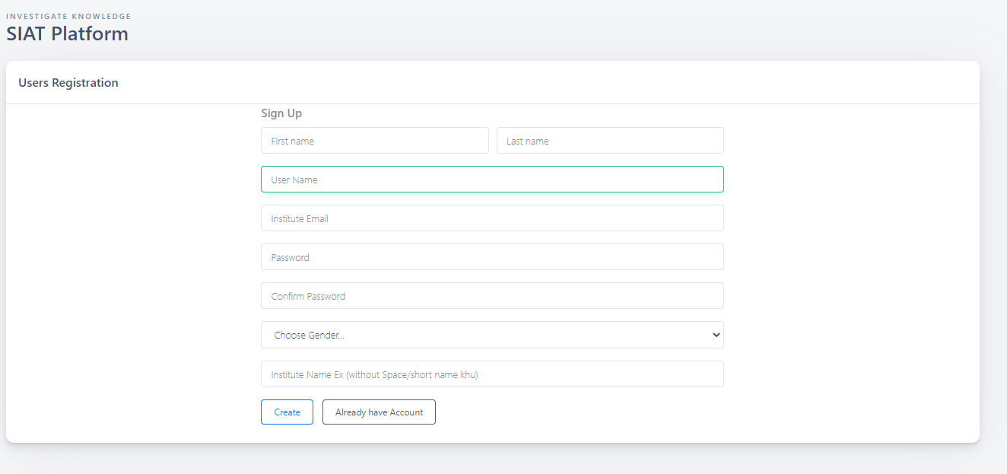
http://163.180.116.234/admin/HTML/register.php
At First, Complete the registration using the given link
Give Institute Name without space. You can use short name.

Slide 10
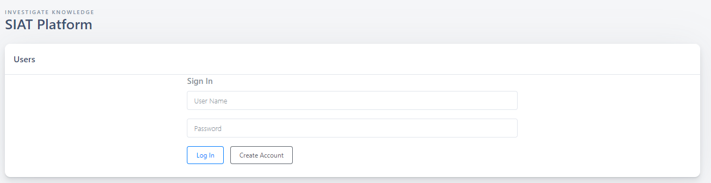
Login with Proper user name and password
http://163.180.116.234/admin/HTML/login.php

Slide 11
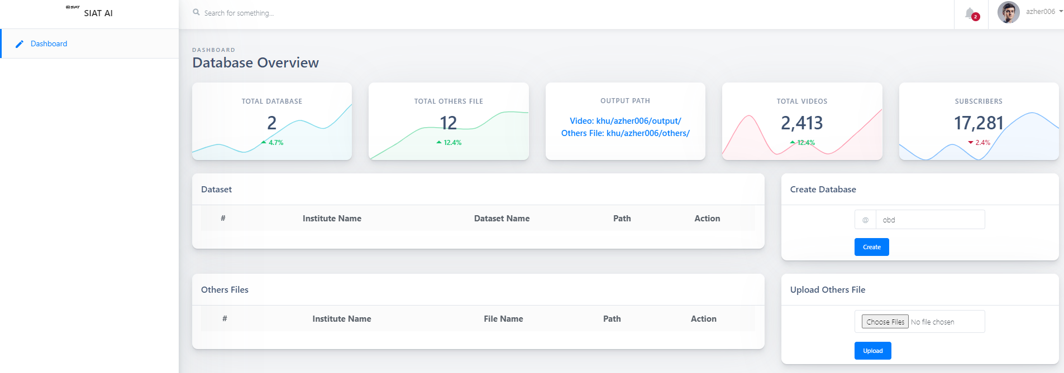
This is the dashboard after login
Create Dataset to upload video
Output path for Video files
Output path for other files
Upload other files such csv file,
which contains the features

Slide 12
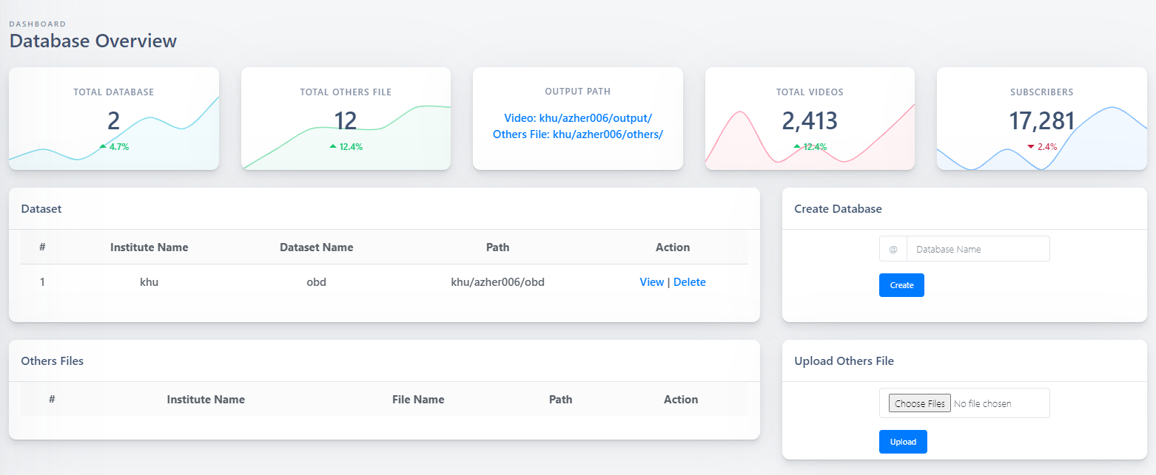
Video dataset create

Slide 13
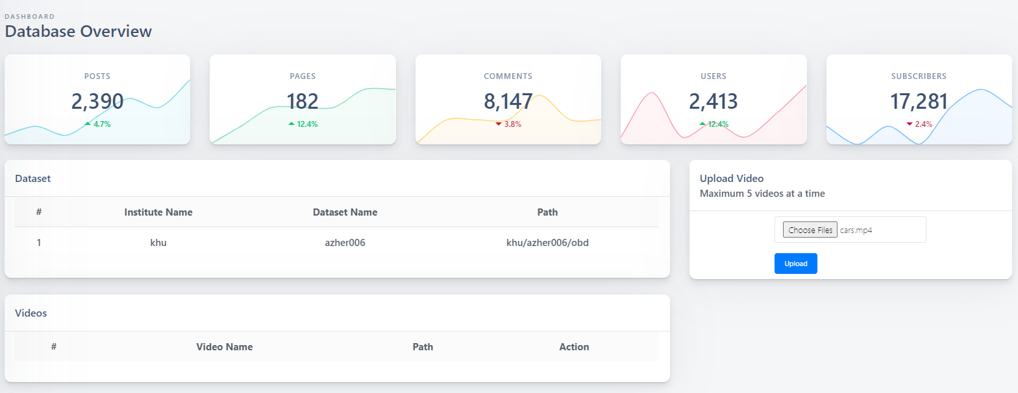
Upload the video

Slide 14
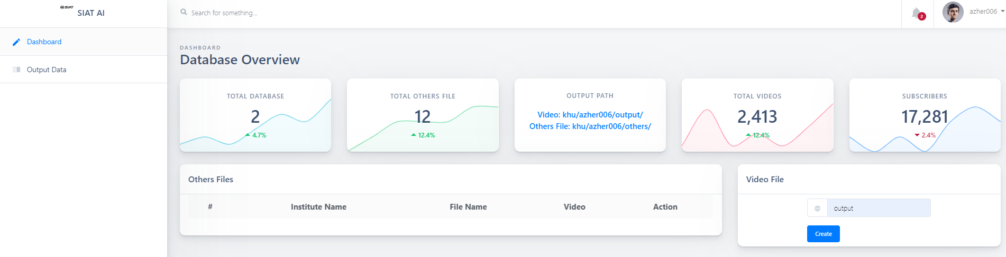
Create file name to download the output
video file

Slide 15
Object Detection from video which takes video as input
import requests
import cv2
import numpy as np
import base64
import json
import pickle
import time
import os
#Object Detection API
url_od = 'http://163.180.116.234:5000/ObjectDetection/'
# headers = {"content-type": "application/json", "Accept-Charset": "UTF-8"}
#data_path is the path you upload the video data get this path from UI
#output_path is the path where the output video data is saved get this path from UI
payload_od = {'data_path': 'khu/azher006/obd/cars.mp4', 'output_path': 'output.mp4'}
r_post = requests.post(url_od, data=payload_od)
data_for_post = r_post.json()
print(data_for_post)

Slide 16


Slide 17
CNN API

Slide 18
Feature Extracting using CNN by taking the frame as input

Slide 19
Feature Extraction using CNN from frame which takes frame as input
#This API extract the CNN feature and takes frame as input
import requests
import cv2
import numpy as np
import base64
import json
import pickle
import time
import os
def json2im(jstr):
"""Convert a JSON string back to a Numpy array"""
load = json.loads(jstr)
imdata = base64.b64decode(load['image'])
im = pickle.loads(imdata)
return im
def im2json(im):
"""Convert a Numpy array to JSON string"""
imdata = pickle.dumps(im)
jstr = json.dumps({"image": base64.b64encode(imdata).decode('ascii')})
return jstr
data_url_1 = "1.jpg"
url_od = ' http://163.180.116.234:5000/CNNFeatureExtractionFrame/'
headers = {"content-type": "image/jpeg", "Accept-Charset": "UTF-8"}
img = cv2.imread(data_url_1)
_, img_encoded = cv2.imencode('.jpg', img)
# send http request with image and receive response
r_post = requests.post(url_od, data=img_encoded.tostring(), headers=headers)
data_for_post = r_post.json()
print(data_for_post)

Slide 20
Feature Extraction using CNN by taking the video data as input
Upload the video data to SIAT cloud

Slide 21
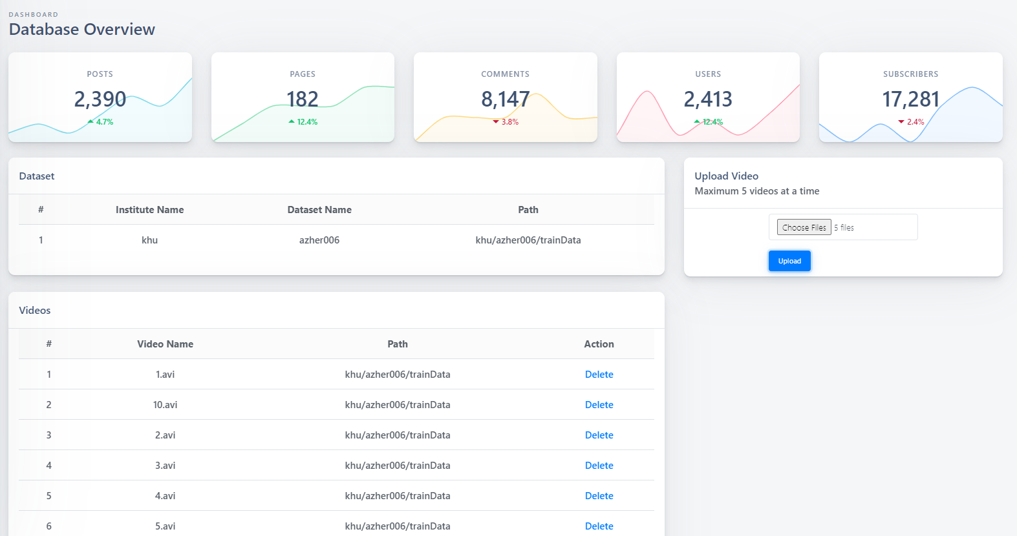
Feature Extraction using CNN From Training Video Data
New Dataset was create to upload video
Upload the video data to train LSTM Model
Dataset Name

Slide 22
Training Video Data
Feature Extraction using CNN from video frames which takes video dataset as input
Extract Feature to train LSTM model
#This API extract the CNN feature and takes video dataset as input
#Capture the features from trained data to train LSTM
import requests
import cv2
import numpy as np
import base64
import json
import pickle
import time
import os
url_od = 'http://163.180.116.234:5000/CNNFeatureExtractionVideo/'
# headers = {"content-type": "application/json", "Accept-Charset": "UTF-8"}
#data_path is video dataset containing the videos from which the feature will be extracted
#output_path is the feature dataset which will be generated
#ext is extension of video data
#no_frame is the number of frames from where feature will be extracted
payload_fe = {'data_path': 'khu/azher006/trainData/', 'output_path': 'khu/azher006/others/trainFeature.csv',
'ext': 'avi', 'no_frame': 90}
r_post = requests.post(url_od, data=payload_fe)
data_for_post = r_post.json()
print(data_for_post)

Slide 23
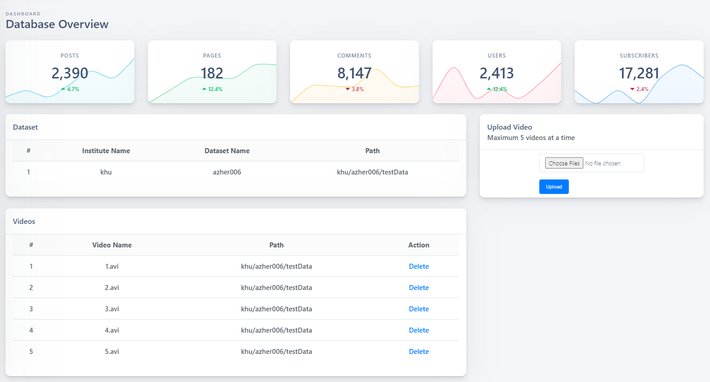
Feature Extraction using CNN From Testing Video Data
New Dataset was create to upload video
Upload the video data to test LSTM Model
Dataset Name

Slide 24
Testing Video Data
Feature Extraction using CNN from video frames which takes video dataset as input
Extract Feature to Test LSTM model
#This API extract the CNN feature and takes video dataset as input
#Capture the features from trained data to train LSTM
import requests
import cv2
import numpy as np
import base64
import json
import pickle
import time
import os
url_od = 'http://163.180.116.234:5000/CNNFeatureExtractionVideo/'
# headers = {"content-type": "application/json", "Accept-Charset": "UTF-8"}
#data_path is video dataset containing the videos from which the feature will be extracted
#output_path is the feature dataset which will be generated
#ext is extension of video data
#no_frame is the number of frames from where feature will be extracted
payload_fe = {'data_path': 'khu/azher006/testData/', 'output_path': 'khu/azher006/others/testFeature.csv',
'ext': 'avi', 'no_frame': 90}
r_post = requests.post(url_od, data=payload_fe)
data_for_post = r_post.json()
print(data_for_post)

Slide 25
LSTM API for Classification

Slide 26
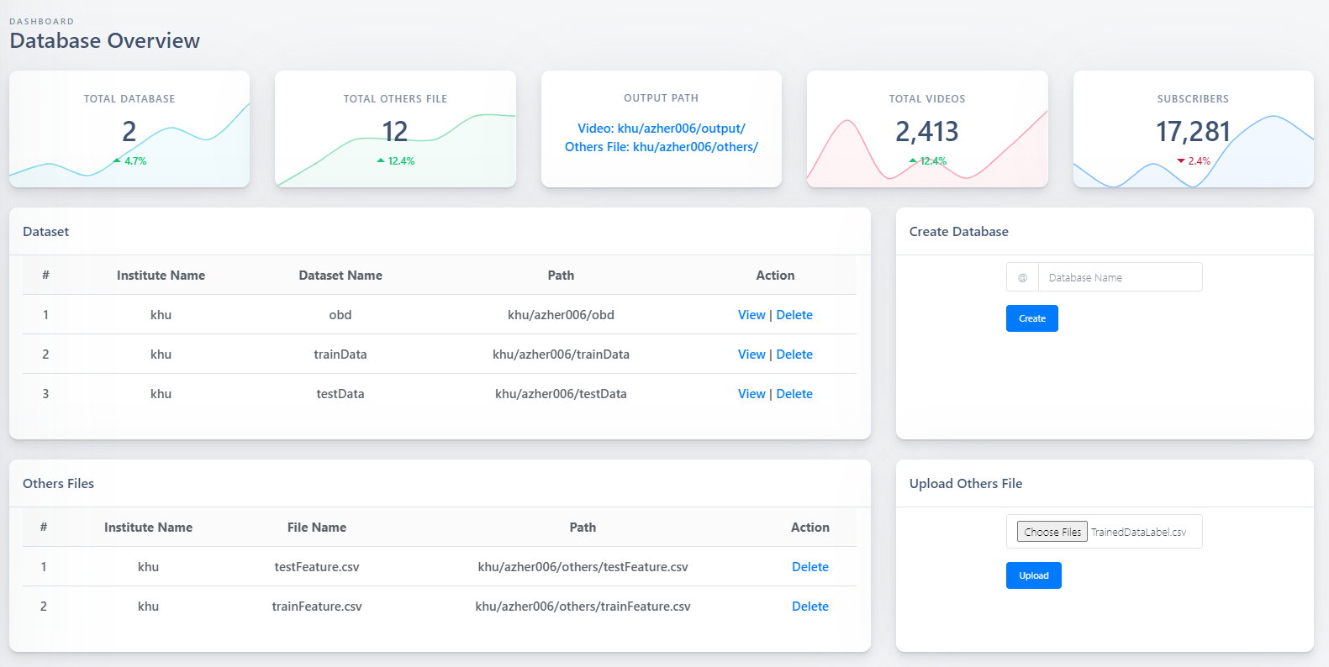
Upload the Train Data Label to test LSTM Model

Slide 27
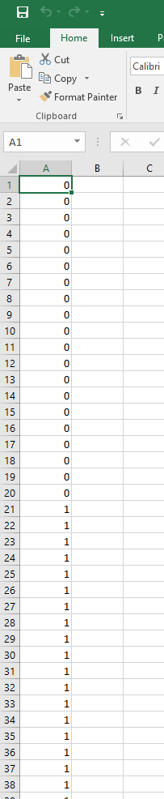
Training Label
For Training, In this example, there are 40 videos, 2 classes,
First 20 videos (1-20) are class 0 and last 20 videos (21-40) are class 1.
CNN Feature are extracted from 90 frames for each videos
The train label should be written in CSV file as shown in the figure.

Slide 28
Train LSTM
#Train LSTM
import requests
#LSTM API
url_lstm = 'http://163.180.116.234:5000/TrainingLSTM/'
# # headers = {"content-type": "application/json", "Accept-Charset": "UTF-8"}
#root path from UI
root_url = "khu/azher006/others/"
#TrainFeature file
TrainFeature = root_url + "trainFeature.csv"
#TrainFeature label file
LabelData = root_url + "TrainedDataLabel.csv"
#Save Model path with Model name
model_path = root_url + "LSTMModel"
#Number of trained video
trainVideo = 40
#Number of frames from ehere feature is extracted
timeStamp = 90
#Number of Features
numFeature = 1000
#Nunber of classes
classes = 2
payload_fe = {'TrainFeature': TrainFeature, 'LabelData': LabelData, 'no_trainVideo': trainVideo,
'no_frame': timeStamp, 'no_feature': numFeature, 'classes': classes, 'model_path': model_path}
r_post = requests.post(url_lstm, data=payload_fe)
data_for_post = r_post.json()
print(type(data_for_post))

Slide 29
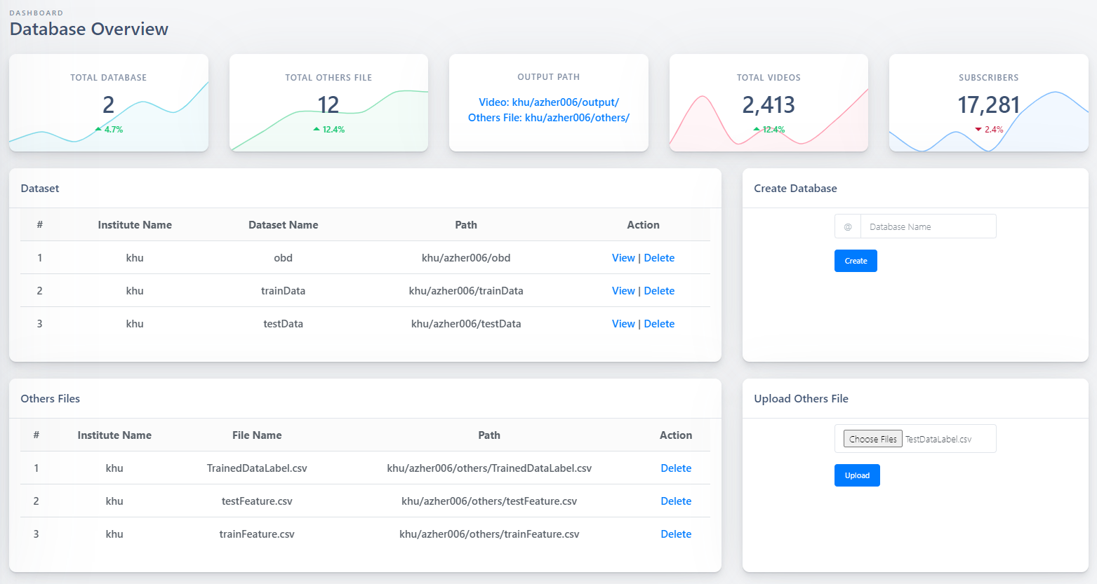
Upload the Test Data Label to test LSTM Model

Slide 30
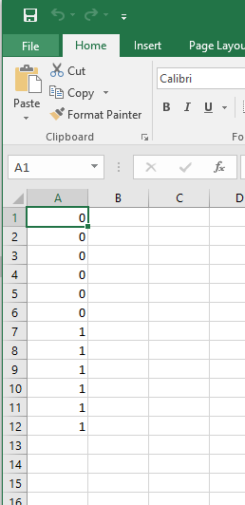
Testing Label
For Testing In this example, there are 12 videos, 2 classes,
First 6 videos (1-6) are class 0 and last 6 videos (7-12) are class 1.
CNN Feature are extracted from 90 frames for each videos
The test label should be written in CSV file as shown in the figure.

Slide 31
Test LSTM
#Test LSTM
import requests
#LSTM test API
url_lstm_test = 'http://163.180.116.234:5000/TestingLSTM/'
# # headers = {"content-type": "application/json", "Accept-Charset": "UTF-8"}
#root path from UI
root_url = "khu/azher006/others/"
#Test Feature file
TestFeature = root_url + "testFeature.csv"
#Test Feature label file
TestLabelData = root_url + "TestDataLabel.csv"
#Load Model path with Model name
model_path = root_url + "LSTMModel"
#Number of Test video
testVideo = 12
#Number of frames from ehere feature is extracted
timeStamp = 90
#Number of Features
numFeature = 1000
#Nunber of classes
classes = 2
payload_lstm_test = {'TestFeature': TestFeature, 'TestLabelData': TestLabelData, 'no_frame': timeStamp,
'no_feature': numFeature, 'no_testVideo': testVideo, 'model_path': model_path}
r_post = requests.post(url_lstm_test, data=payload_lstm_test)
data_for_post = r_post.json()
print(data_for_post)

